Slide 1
Name Parts of a Circle
We are Learning to……

Slide 2


Naming the parts of a circle
A circle is a set of points equidistant from its centre.
The distance around the outside of a circle is called the circumference.
diameter
The radius is the distance from the centre of the circle to the circumference.
radius
centre
The diameter is the distance across the width of the circle through the centre.
circumference
Notes:
Link:
S6 Construction and loci – The locus of point from a fixed point

Slide 3
Arcs and sectors
arc
An arc is a part of the circumference.
sector
a sector is formed.
When an arc is bounded by two radii
Notes:
You may like to add that an arc that is shorter than a semi-circle is a minor arc and an arc that is longer than a semi-circle is a major arc.

Slide 4
Triangles from chords and radii
A chord AB is drawn as follows.
B
Two radii are then drawn from the end points of the chord, A and B, to the centre of the circle O.
A
What is the name
of shape ABO?
O
Will an isosceles triangle always be produced by a chord and the radii through its end points?
Notes:
Establish that an isosceles triangle will always be produced when the end points of a chord are joined to the centre of a circle.

Slide 5
Inscribing regular polygons in circles
A chord AB is drawn so that it is the same length as the radius of the circle.
Two radii are then drawn from the end points of the cord, A and B, to the centre of the circle O.
B
What is the name
of shape ABO?
A
O
Chords of equal length to the radius are drawn right around the circumference of the circle.
What shape is
formed as a result?
Notes:
Establish that 6 chords will fit exactly around the circumference of a circle if they are the same length as the radius. This will produce a regular hexagon from 6 equilateral triangles.

Slide 6
Inscribing regular polygons in circles
When a polygon is drawn inside a circle we say that it is inscribed in the circle.
Any regular polygon can be inscribed in a circle by drawing equal chords around the circumference.
72°
A pentagon is inscribed in the circle.
a
What is the size of the
angle at the centre, a?
How could we use a ruler, a protractor and a compass to draw any given regular polygon inside a circle?
Notes:
Define the angle at the centre of a polygon. For a regular polygon, this angle is equal to 360° ÷ the number of sides.
Ask pupils to explain why the angles at the centre of a regular polygon are the same as their exterior angles. (Remind them that the sum of the exterior angles of a polygon is always 360°).
Discuss how we could use a ruler, a protractor and a compass to construct any regular polygon inside a circle.

Slide 7

Investigation Time
Follow the investigation on the next few slides.
We are looking to see if we can find any patterns in our results.
You will need to create a table with room to record five sets of results:
Radius, r (cm) | Diameter, d (cm) | Circumference, C (cm) | C ÷ d

Slide 8
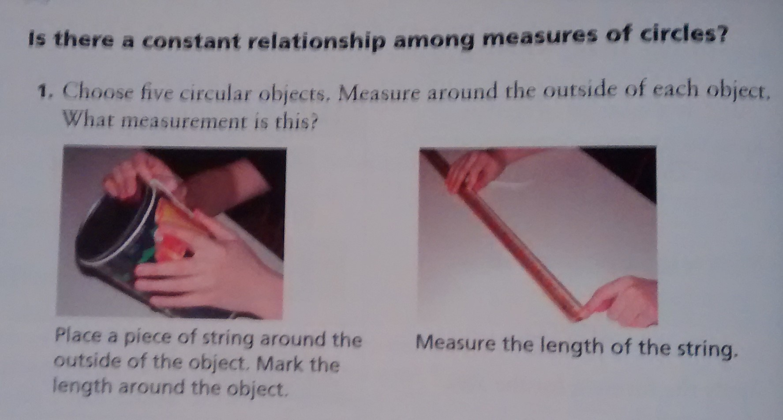

Slide 9
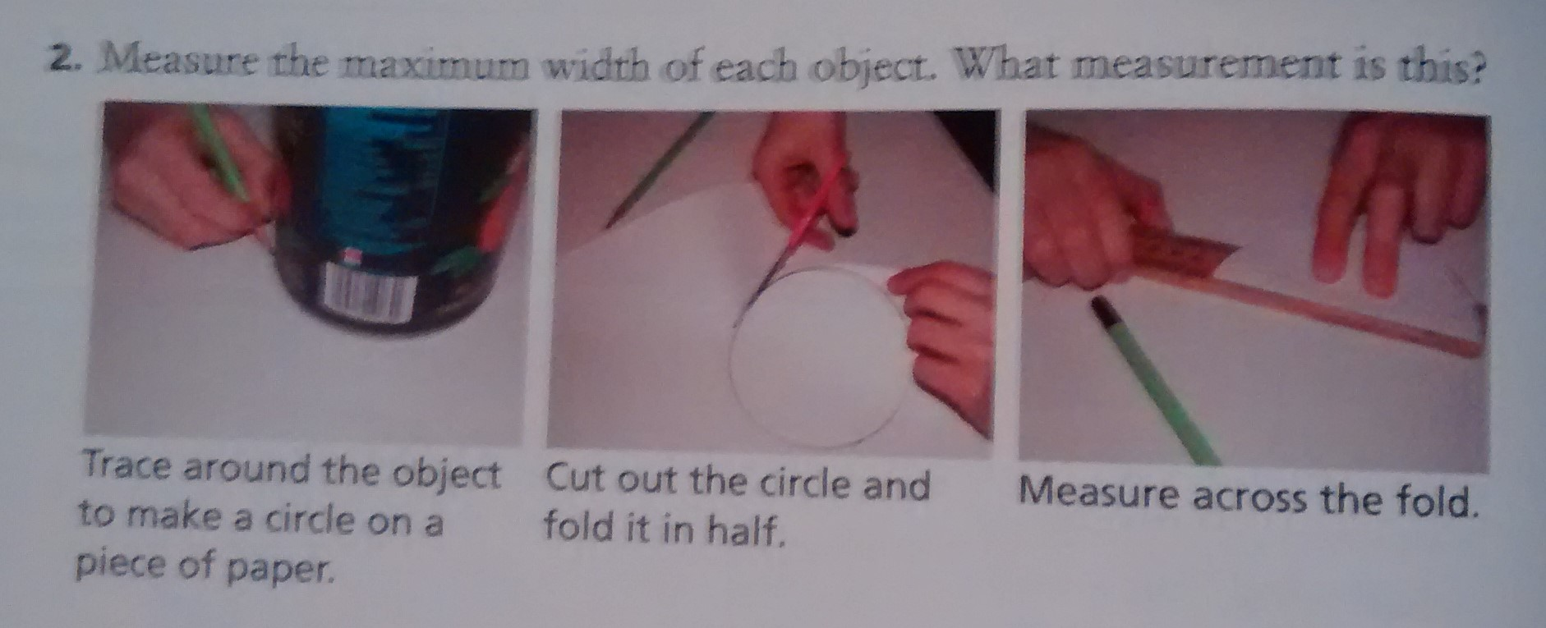

Slide 10
